Slide 1
Virtualization
Oleksandr Aleksandrov
Senior Software Engineer
December 2020

Slide 2
About me
https://www.linkedin.com/in/aleksandrovoleksandr/
https://github.com/Pivopil
https://www.credential.net/73ceafb6-a0b5-4c8d-86cb-4eb02f3ecfcb?key=1be68468ed2f07c6b190a1a0897551e7faf8697d9ba643f6cd1afd2fe7c1d665

Slide 3
Agenda
Timeline
Part 1
Virtualization timeline
Virtualization levels
Part 2
Create your Google Identity
Get $300 for free
Set up Google Cloud CLI
Create seed folder, project, and service account
Part 1: 09:00 - 09:40
Part 2: 09:40 - 10:20
Q&A: 10:20 – 10:30

Slide 4
Part 1

Slide 5
Mind Maps...

Slide 6
Part 2

Slide 7
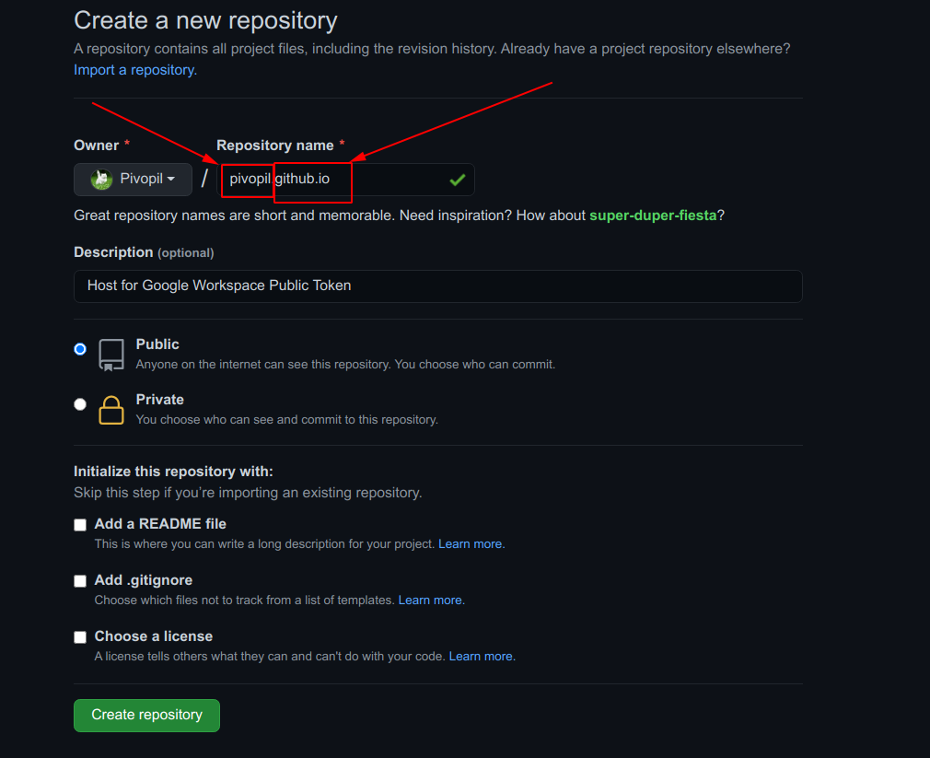
Create host repository in your GitHub [YOUR_ACCOUNT_NAME].github.io

Slide 8
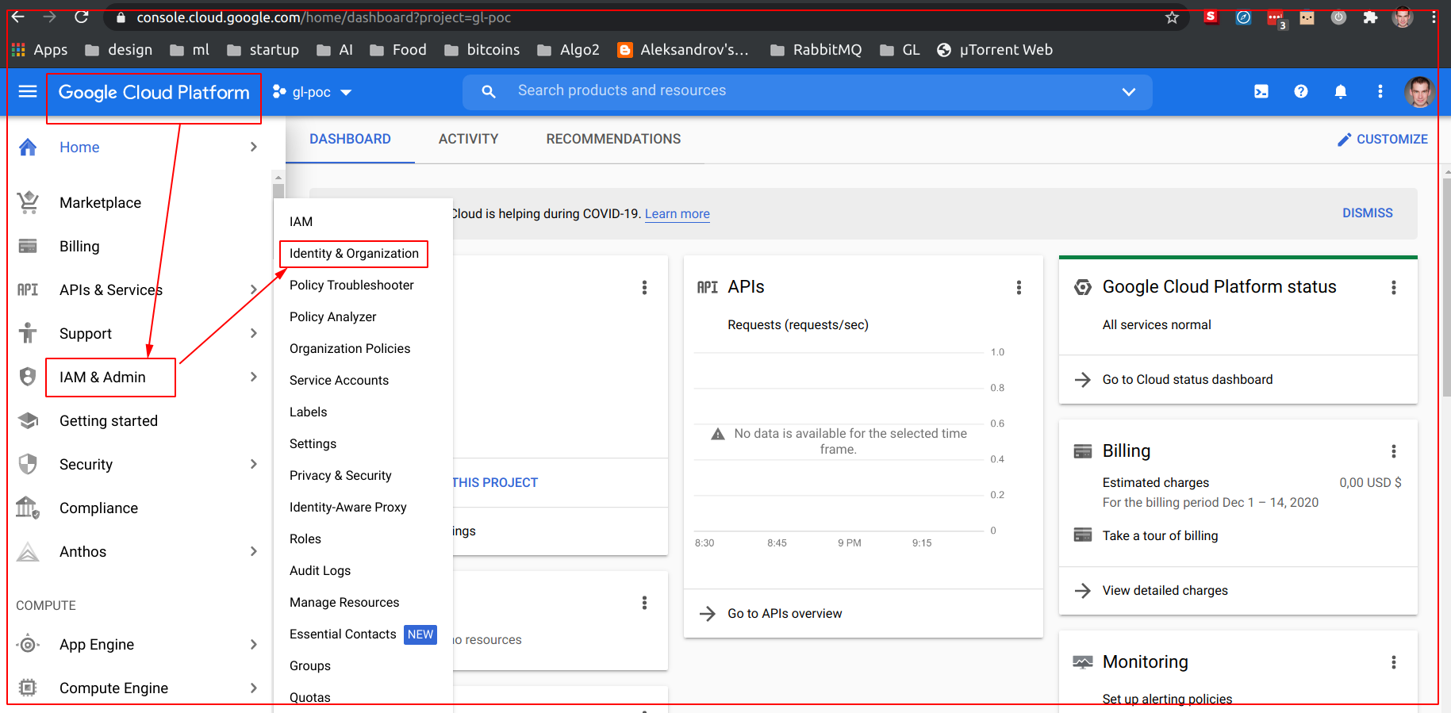
For your Gmail account, go to console.cloud.google.com, select IAM & Admin, and then select Identity & Organization

Slide 9
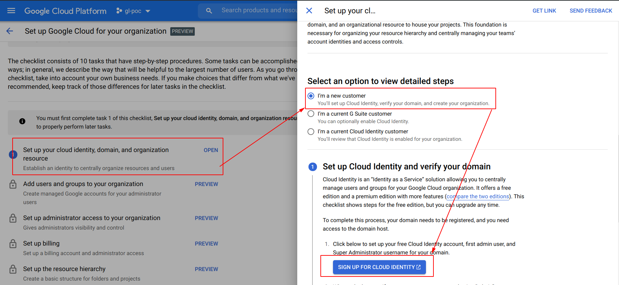
Select Set up your cloud identity > I’m a new customer > SIGN UP FOR CLOUD IDENTITY

Slide 10
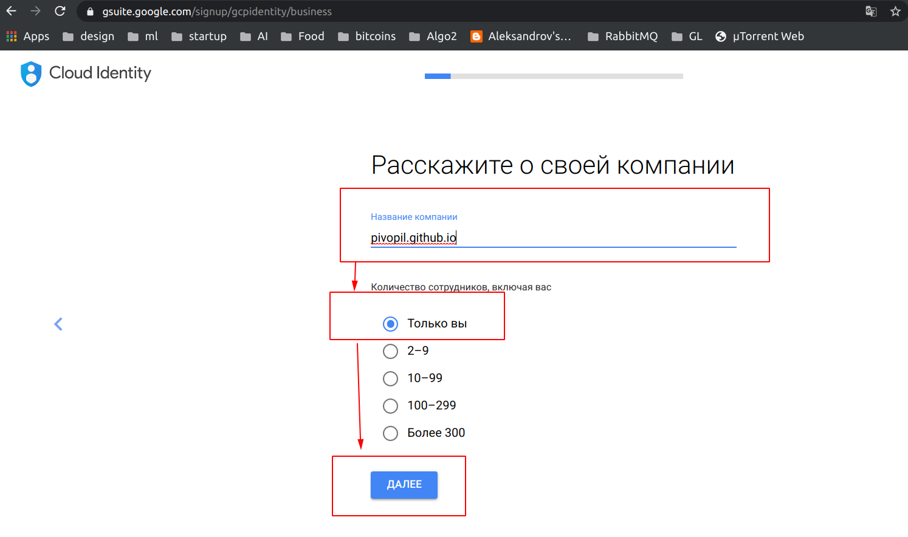
Type [YOUR_ACCOUNT_NAME].github.io as your company name

Slide 11
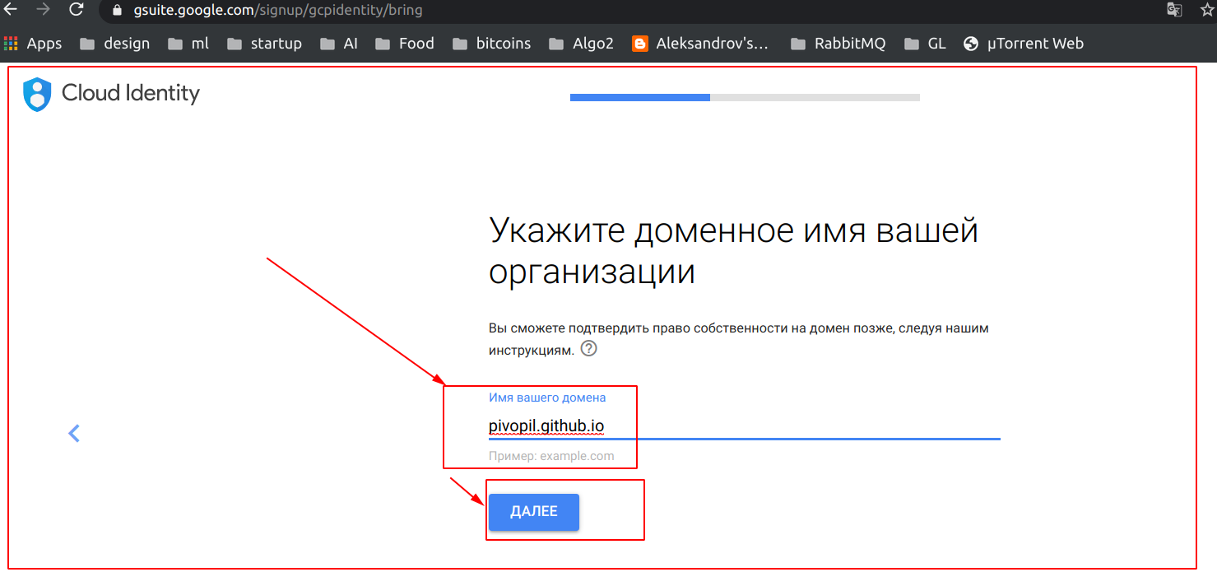
Type [YOUR_ACCOUNT_NAME].github.io as your domain

Slide 12
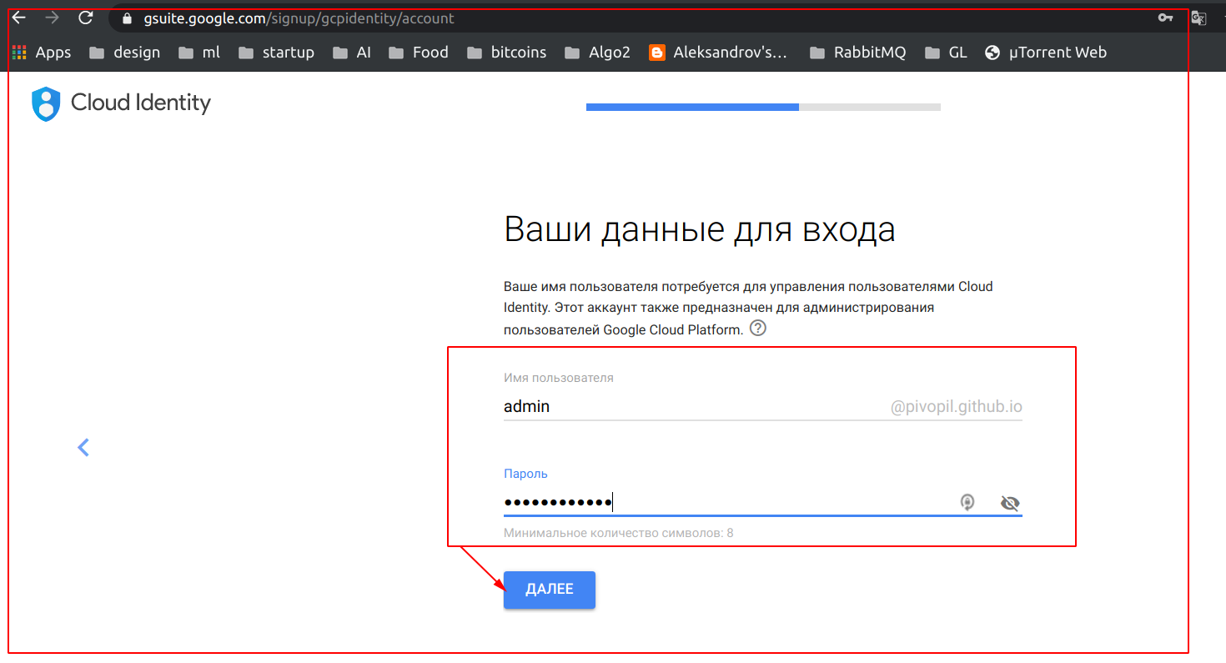
Create admin user for your [YOUR_ACCOUNT_NAME].github.io account

Slide 13
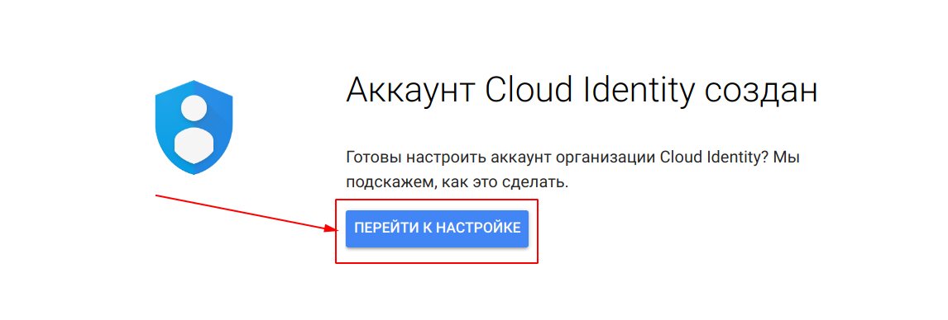

Slide 14
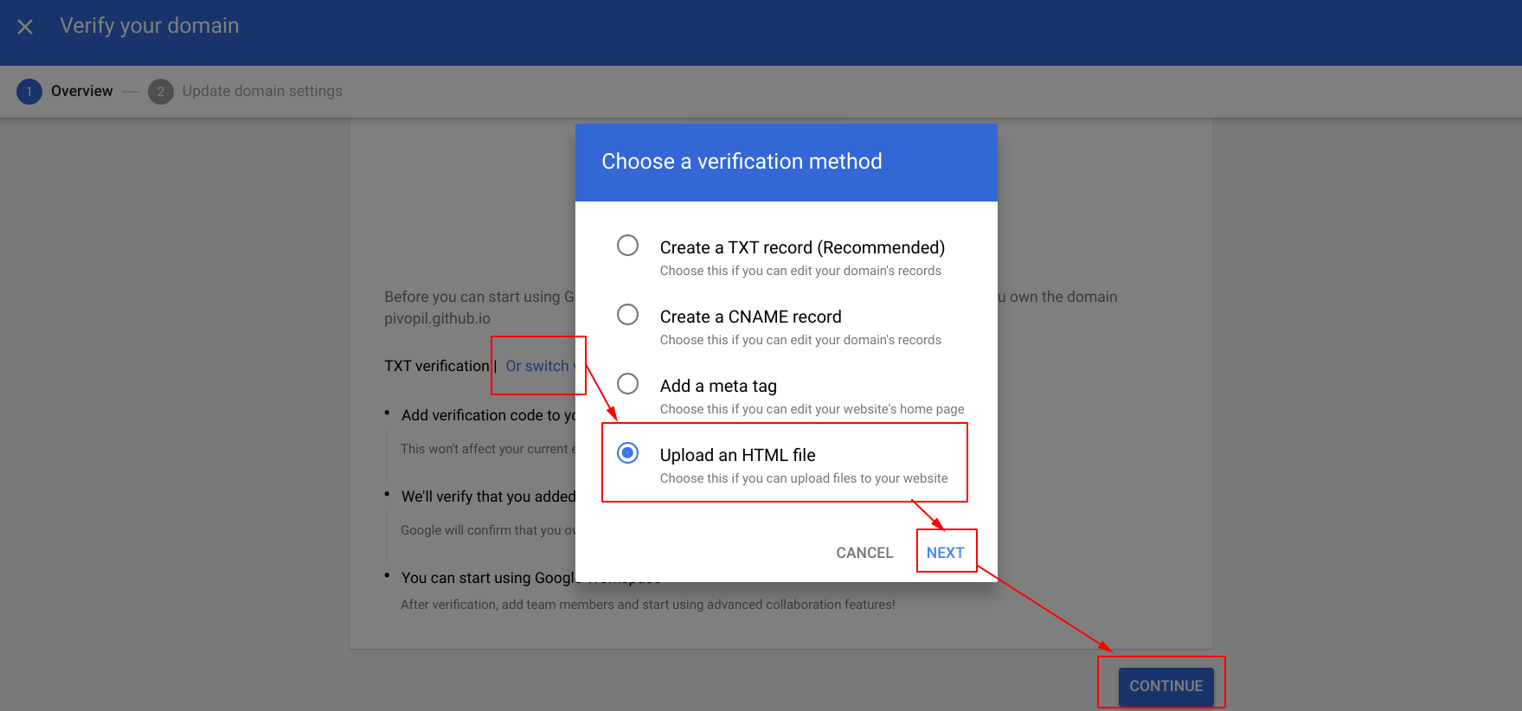
Choose Upload an HTML file as your domain verification

Slide 15
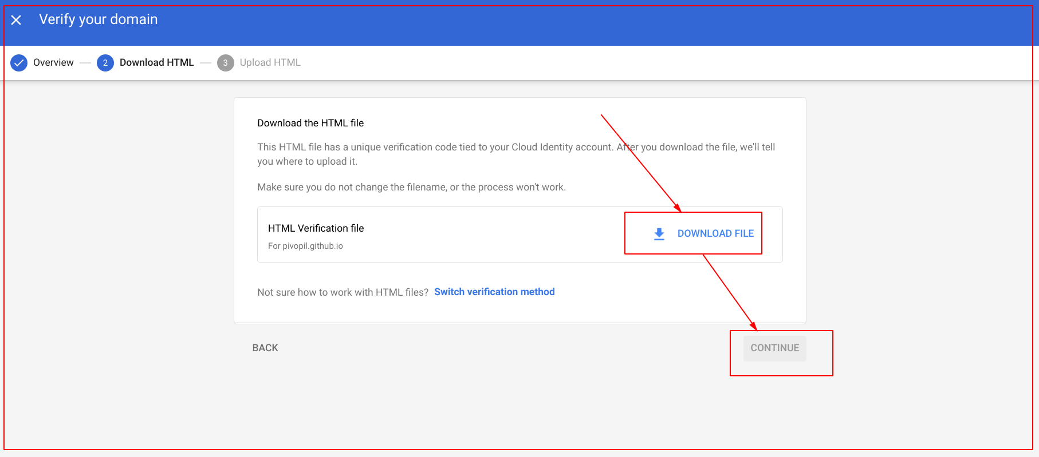
Download the file

Slide 16
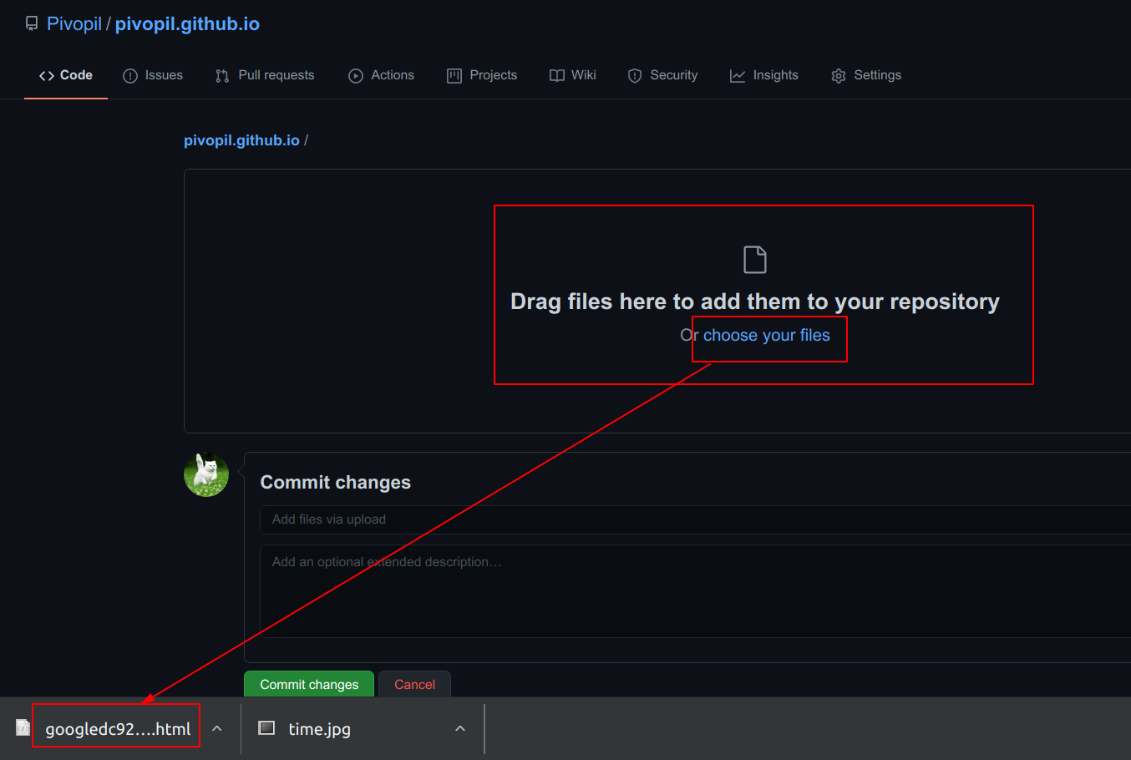
Upload the file with the verification token to the newly created GitHub repo

Slide 17
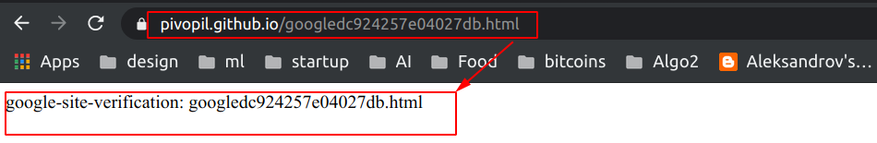
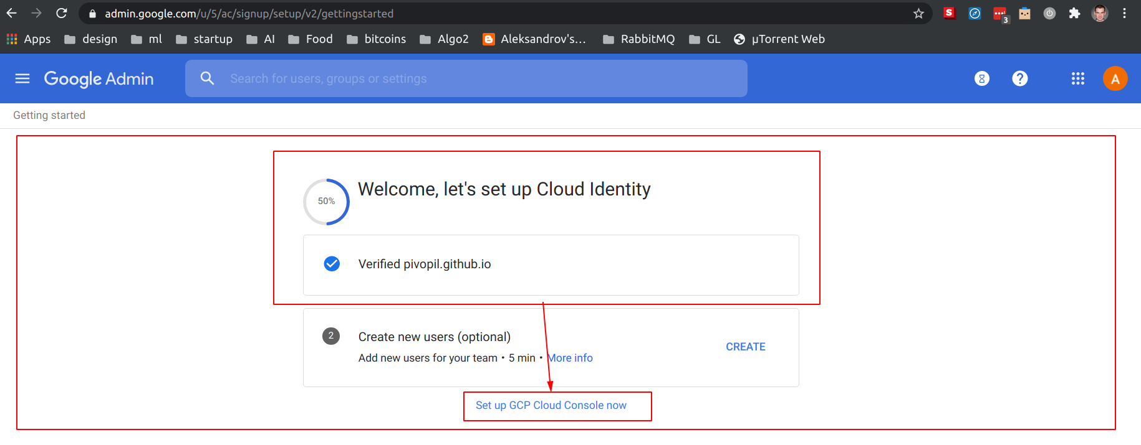
GitHub will work as a host for your verification, and you will see Verified icon in your browser

Slide 18
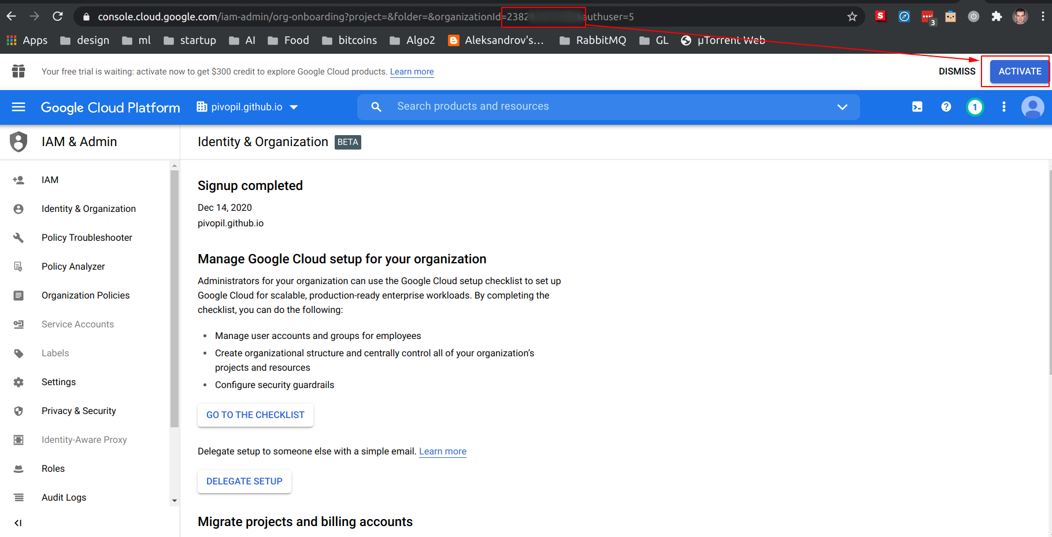
Activate your account to get $300 credits

Slide 19
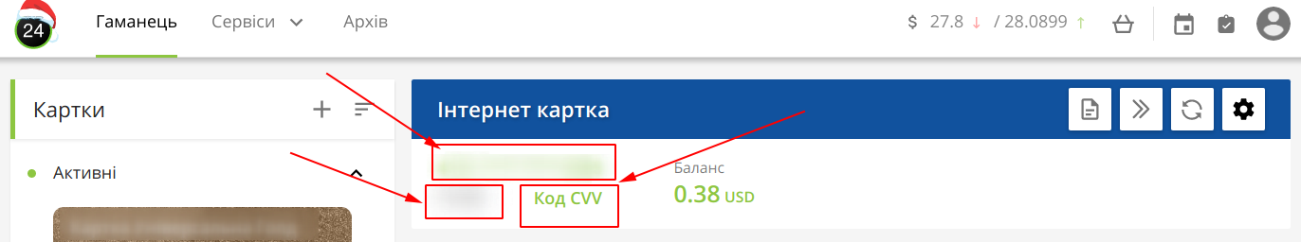
Use only virtual card with $1 to verify your billing for Google

Slide 20
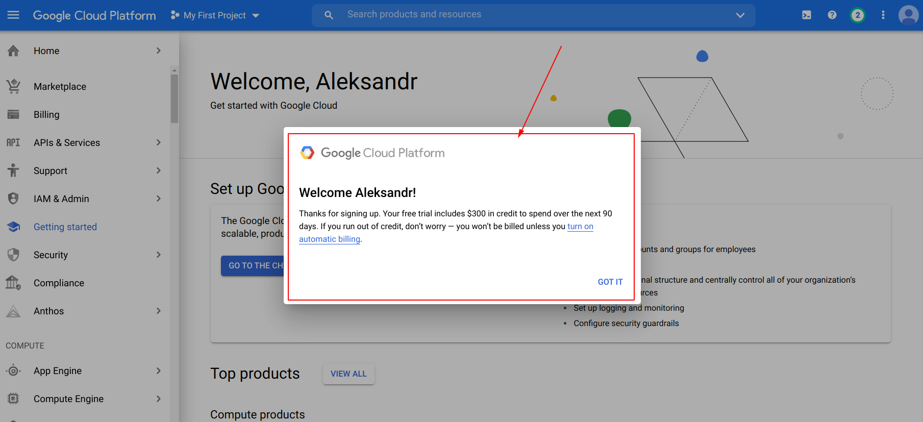
Then, you will see the final screen

Slide 21
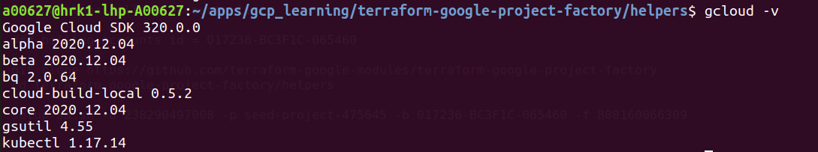
Install Google Cloud CLI apps for your OS
You need gcloud and gcloud alpha. The result should be the following:

Slide 22
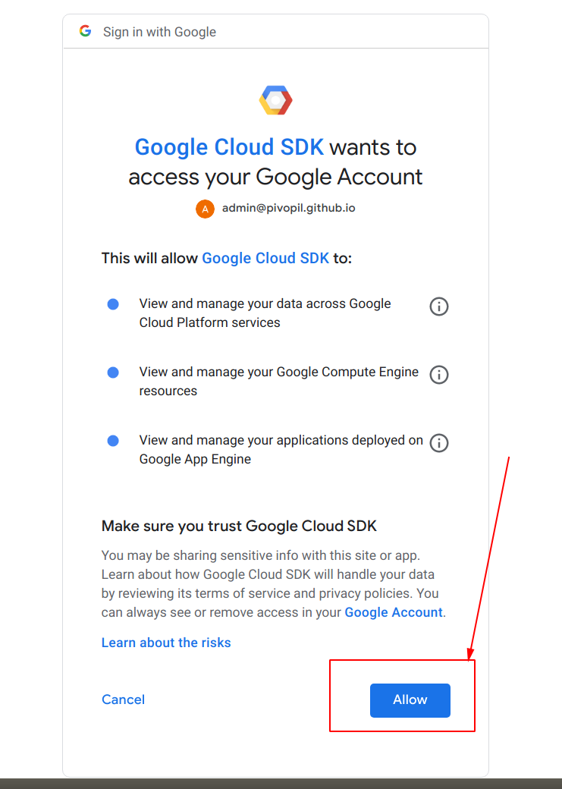
Log in to Google Cloud using terminal
gcloud auth login
admin@[YOUR_GITHUB_ACCOUNT_ID].github.io
The result should be the following but for your [GITHUB_ACCOUNT]:
gcloud organizations list
You will need your organization ID for the next step

Slide 23
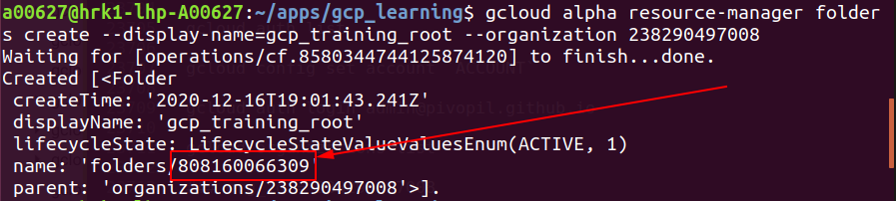
Create project folder and seed project
Run the next commands in the terminal:
gcloud organizations add-iam-policy-binding [YOUR_ORGANISATION_ID] \ --member=user:admin@[YOUR_GITHUB_ACCOUNT_ID].github.io \ --role=roles/resourcemanager.folderAdmin
gcloud alpha resource-manager folders create --display-name=gcp_training_root --organization [YOUR_ORGANISATION_ID]
Use your folder ID to create project in it, and then set project as default for Google Cloud:
gcloud projects create [YOUR_SEED_PROJECT_NAME] --folder=[YOUR_ROOT_FOLDER_ID] gcloud config set project [YOUR_SEED_PROJECT_NAME]

Slide 24
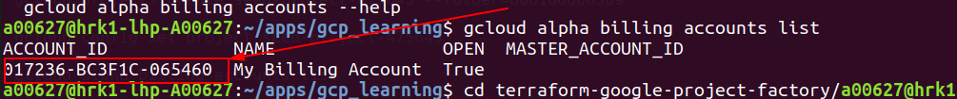
Get your billing account ID
gcloud alpha billing accounts list
Clone terraform-google-project-factory from GitHub, and then create your service account:
git clone https://github.com/terraform-google-modules/terraform-google-project-factory cd terraform-google-project-factory/helpers
setup-sa.sh -o [YOUR_ORGANISATION_ID] -p [YOUR_SEED_PROJECT_NAME] -b [YOUR_BILLING_ACCOUNT_ID] -f [YOUR_ROOT_FOLDER_ID]

Slide 25
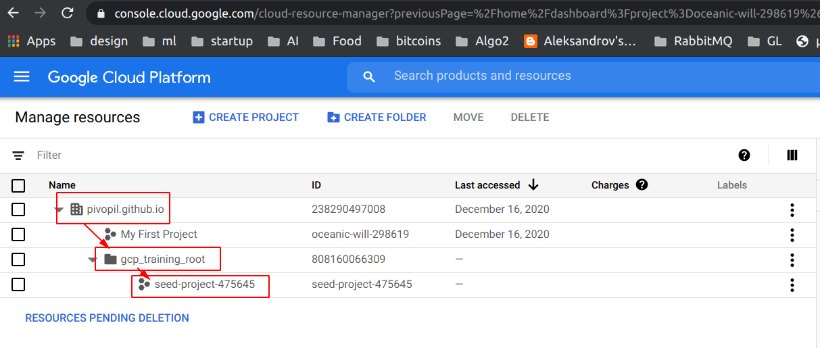
You will get credentials.json file in your working directory and use it for all your developments
In your GCP account, in Resource manager, you will get the next structure:

Slide 26
Thank you

